Slide 1

AZ Health Zone
Gardening Curricula Webinar
August 30, 2018
Notes:
Monthly Webinar Series – Farm to School
Join us to explore the connection between SNAP-Ed and Farm to School and learn about opportunities for LIAs to support PSE changes within this strategy. A recording will be shared after the webinar.
Date: 1/17/2018
Time: 10:00 - 11:00 a.m.
Presenters: Ashley Schimke, ADE Farm to School Specialist & Jesse Davenport, AZ Health Zone Food Systems Specialist
GoToMeeting Join Link: https://www.gotomeet.me/AzHealthZone
For audio, use your device speaker and microphone. Or dial-in to the toll-free conference line: 1-866-899-4679
Access Code: 722-019-405

Slide 2
Part 1 - Presentation
Welcome & Opening
Refresher of common terms
  Such as evidence-based, approved, audience, embedded assessment, implementation guidelines, etc.
Overview of approved gardening curricula
  Early Childhood
  Elementary - Wide Age Range
  Elementary - Narrow Age Range
  Middle School
  What about adults?

Slide 3
Part 2 - Discussion
Questions & Comparisons
  Including content, lesson length, minimum lessons, tie to actual garden, etc.
Peer-sharing
  Which curriculums are you currently using and in what settings?
  What advice would you give to fellow SNAP-Ed staff about how to use the curriculums you’re familiar with?
  Are there any curriculums you’ve tried but decided not to use? Why?
  Are you considering any changes in which curriculums you use or how you use them?
  What did you learn in this webinar that may change your DE connected to gardens?
Evaluation & Closing

Slide 4

Opening
Goal? Continue making strategic choices
How? With information & reflection

Slide 5
Common Terms
Evidence-based
Approved
Audience
Number of lessons
Lesson length
Embedded assessment
Implementation guidelines

Slide 6
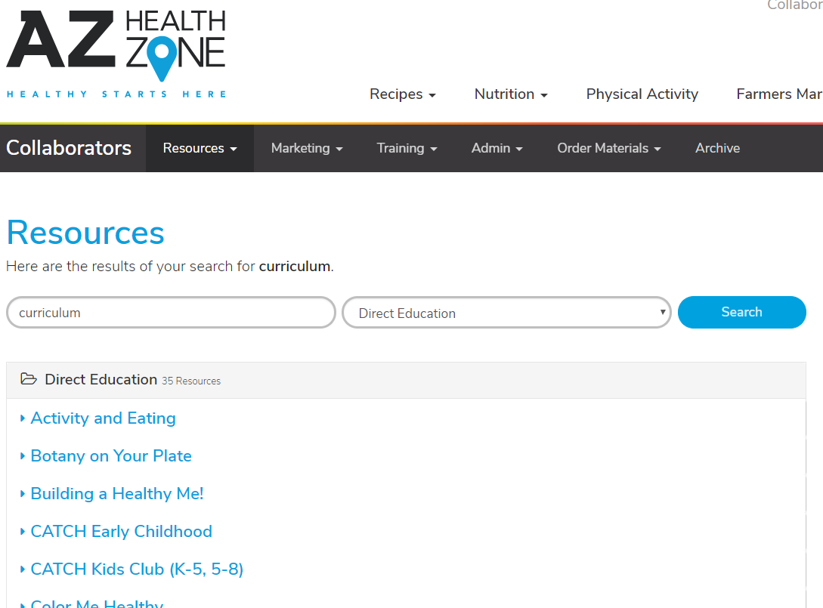
Where to find all the details

Slide 7


Pre-K Gardening Curricula

Slide 8



Elementary Garden Curriculum
K-4
K-5
K-5

Slide 9




Elementary Garden Curriculum
2-5
3-4
3-5
3-5

Slide 10


Upper Elementary/Middle School

Slide 11

What about adults?
AZ version available October 1

Slide 12
Pre-K Comparison

Slide 13
Elementary (Wide) Comparison

Slide 14
Elementary (Narrow) Comparison

Slide 15
Upper Elementary/Middle School Comparison

Slide 16
Questions???

Slide 17
Peer-Sharing Discussion
Which curriculums are you currently using and in what settings?
What advice would you give to fellow SNAP-Ed staff about how to use the curriculums you’re familiar with?

Slide 18
Peer-Sharing Discussion
Are there any curriculums you’ve tried but then decided not to use? Why?
What specific problems have you encountered with our curricula?

Slide 19
Peer-Sharing Discussion
Are you considering any changes in which curriculums you use or how you use them?
What did you learn in this webinar that may change your direction education related to gardening?

Slide 20
Peer-Sharing Discussion
What ideas do you have for leveraging curriculum in multi-level interventions?

Slide 21
Evaluation
PLUSES: What did you like about this webinar?
DELTAS: What would you change about this webinar?

Slide 22
Closing
Find all curriculum details at AZHealthZone.org under Collaborators section. Type “curriculum” into the search bar
Refer to our Curriculum Modification Guidelines found on page 2-3 of the Policies & Procedures Manual

