Slide 1
Active Living Subcommittee
June 20th, 2017
WELCOME

Slide 2
Time | Topic | Presenter
10:00- 10:05 AM | Welcome and roll call Feedback from Subcommittee: | Kevin
10:05- 10:35 AM | Updates and Ideas from Kay | Kay Orzech
10:30- 10:45 AM | Reflection on Active Living committee. (What are some ways that we can create new opportunities for Physical Activity and incorporate them into our everyday work.) EXP. School Gardening/Community Gardening. | Group (facilitated by Kevin Bawden)
10:45- 11:00 AM | Framing Activity: What does transportation have to do with health? Top Five Concerns from the SNAP Eligible Population and Local Governments | Gabby Barilla-Longoria

Slide 3
Subcommittee Feedback
Does the AL subcommittee want to continue to meet?
If so, how often would you like the AL subcommittee to meet?
Would you like to see any changes to the structure of the meetings?
Are you interested in being a subcommittee lead?

Slide 4
California SNAP-Ed: PSEs across site types*
At Schools
At ECEs
257 sites = 1+ PSE change
Avg 2.7 changes per site
<20% of sites did PA changes
<6% of sites changed PE
23% made nutrition & PA changes
120 sites = 1+ PSE change
Avg 5 changes per site
>40% of sites did PA changes
57% made nutrition & PA changes
* Data is from CA Health Departments doing SNAP-Ed

Slide 5


California SNAP-Ed: State Level Partnership
A state-level SNAP-administrator mentioned a pilot program they have in the works:
A partnership between CA State Level Parks & Rec Dept (who oversee county and municipal parks) and SNAP-Ed to encourage SNAP-Ed programming in underutilized parks

Slide 6
Partnerships Beyond Public Health
How can we align with other (non-public-health) organizations?
  If we go far enough upstream, we’re all working toward similar goals
  For example: Climate change and public health – more walking and biking (active transportation) and transit use are good for both
  For example: Infrastructure changes – who benefits beyond public health if infrastructure (sidewalks, crosswalks, etc.) is improved?
    Economic benefits for businesses in more walkable areas

Slide 7
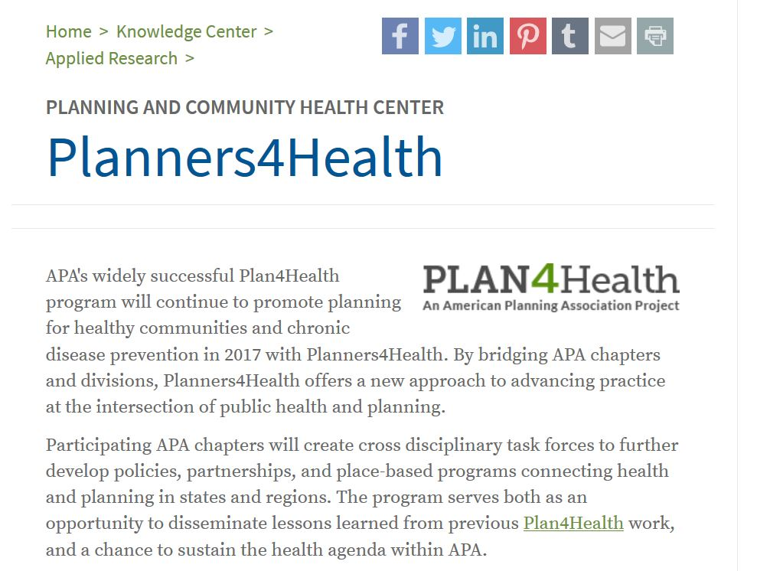
Plan4Health
A grant program (now ended) by Centers for Disease Control (CDC) that brought together public health and planning professionals
Now, there is Planners4Health – a grant through state-level chapters of the American Planning Association
There is a “Planning and Community Health” section on the American Planning Assn’s website: https://www.planning.org/nationalcenters/health/

Slide 8
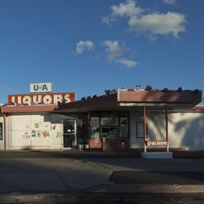
Questions to Think On
Can you walk to a park you feel safe in within 15 minutes?
Is it easier in your neighborhood to buy alcohol than fresh fruit/veg?
Do you or a loved one suffer from a chronic disease?

Slide 9
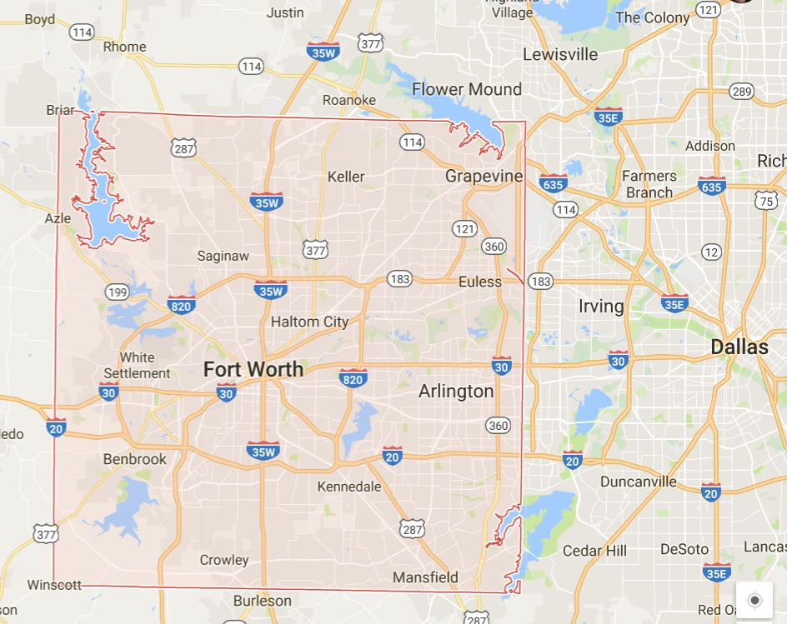
Tarrant County, TX (Fort Worth & beyond)
“many grants, little change”
Turning points:
  The county comprehensive plan included a chapter on health in 2000
  The county passed a “health in all policies” resolution (though didn’t act on it)
  The county health department and local hospital became “mother friendly” – this was a “health policy isn’t so bad!” moment
  Hospital wanted to respond to inappropriate emergency department usage
Directions:
  Community priority was for healthy food closer to home
  Speaker’s call to action – Ft. Worth has 40 commissions, boards – you can register online to serve as an advisor & make your voice heard – do it!

Slide 10
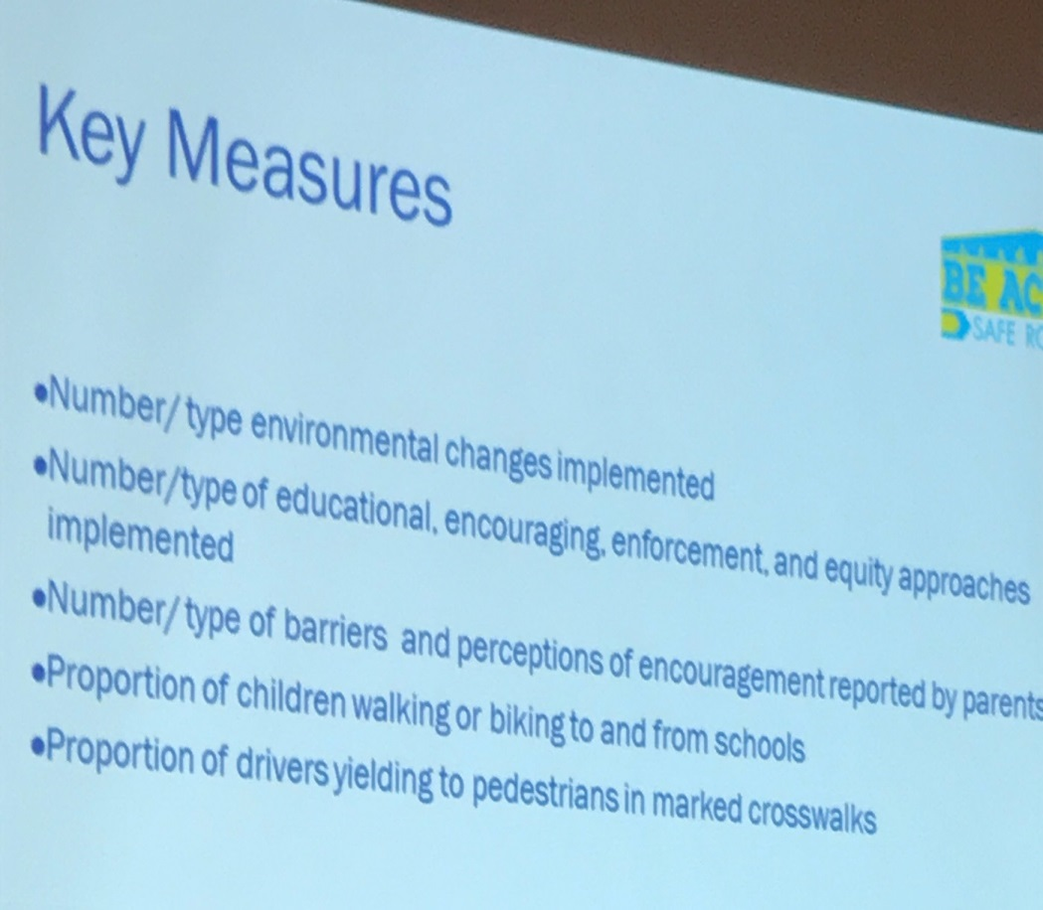
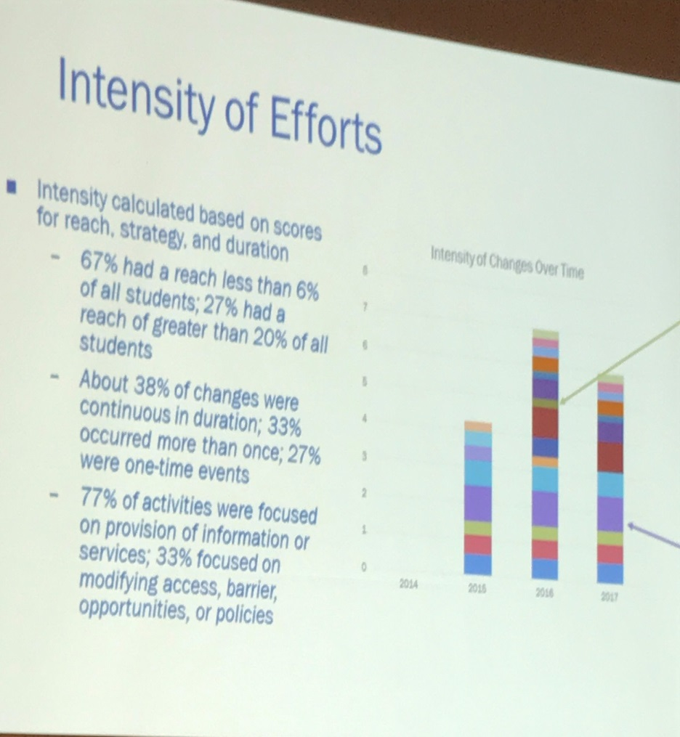
Safe Routes To School Ideas (Applied More Broadly) – Key Measures & What is Happening?
Interrelationships across measures…

Slide 11
Joint Use Roundtable Discussion
Best Practices
Barriers
Working at school site level – starting small (Winton, CA Ex.)
Working at state level (board of ed) then getting districts to adopt – “roadshow” (SC)
Encouragement/Incentives (CA)
  Provide trash cans
  Install water stations
Start where school feels comfortable (SC)
Fear of liability – for vandalism, violence
  State laws/policies (AZ, SC)
  Approach school risk management/insurance (State School Insurance Trust?) (CA)
Fear of publicizing “openness”
  State Board of Education adopted an “open community use” policy (SC)
  Creation of lovely signs…that no one wants to post (SC)
Champions leave
  Find 2 per site!(SC)

Slide 12
Framing Activity - Gabriela
Open “Framing Activity Final” pdf

Slide 13
Wrapping Up
Open Discussion:
  How can we use the AL subcommittee in FY17 to help develop new ideas and potential new directions/ execute current ideas for our individual SNAP-Ed county programs moving forward?
Call for new agenda items

