Slide 1
Active Living Subcommittee
April 18th, 2017
WELCOME

Slide 2
Time | Topic | Presenter
10:00- 10:15 AM | Welcome and roll call Any AZNN updates: | Ryan Lang
10:15- 10:30 AM | Active Living PSE – Continuation of Conference Breakout Session | Ryan Lang
10:30 – 10:40 AM | Brainstorm from Doing PARAs | Kay Orzech
10:40- 10:50 AM | Shared-Use Agreement | Ryan Lang
10:50- 11:00 AM | Open Discussion: | Group

Slide 3
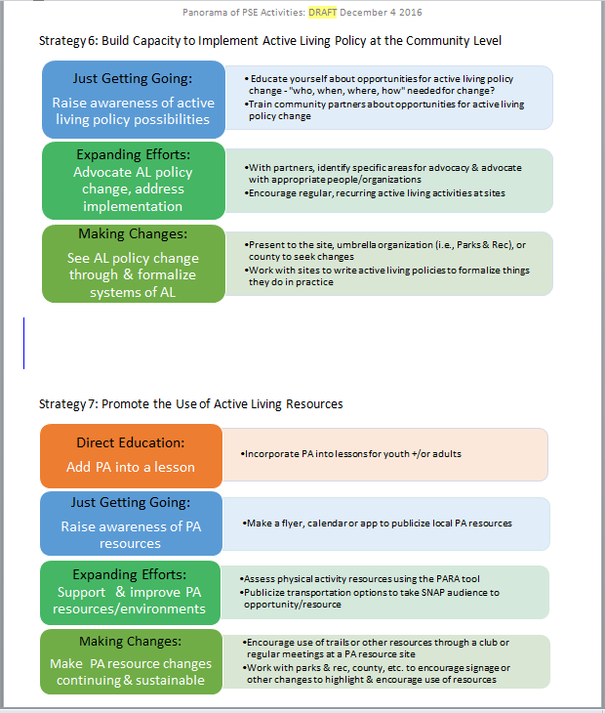
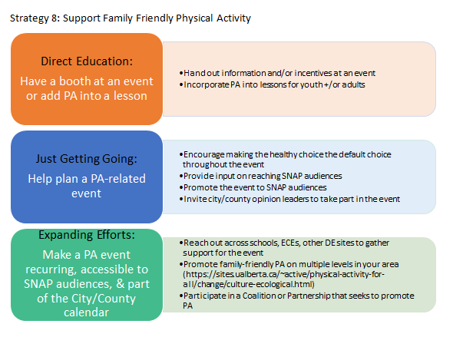
AL PSE Panorama

Slide 4

Success Stories to Make You Think
Direct education (DE) can lead to active living PSE engagement
Use your Adult DE findings for good
The Physical Activity Resource Assessment (PARA) can give you ideas
Infrastructure

Slide 5
Let’s talk Liability
Recreational User Statute – ARS § 33-1551
http://www.azleg.gov/ars/33/01551.htm
School Immunity – ARS §§ 15-1105; 15-183
http://www.azleg.gov/ars/15/01105.htm
http://www.azleg.gov/ars/15/00183.htm
No protection for gross negligence or intentional misconduct

Slide 6
Recreational User Statute
ARS § 33-1551
Specified schools have immunity from liability for use of school grounds by recreational or educational users
A public or private owner, easement holder, lessee, tenant, manager or occupant of premises is not liable to a recreational or educational user except on a showing that the owner, easement holder, lessee, tenant, manager or occupant was guilty of wilful, malicious or grossly negligent conduct that was a direct cause of the injury to the recreational or educational user.
Recreational user does not include a student who is registered at a school during designated times that the student is allowed to be on the school grounds as determined by district personnel or who is participating in a school-sanctioned activity.
Defined exterior school grounds as “park” during non-school hours and gave the same protections as other city/state parks
  "Premises" means agricultural, range, open space, park, flood control, mining, forest, water delivery, water drainage or railroad lands, and any other similar lands, wherever located, that are available to a recreational or educational user, including paved or unpaved multiuse trails and special purpose roads or trails not open to automotive use by the public and any building, improvement, fixture, water conveyance system, body of water, channel, canal or lateral, road, trail or structure on such lands.
Did not include pools and other aquatic features
"Park" includes outdoor school grounds that are open to recreational users, excluding swimming pools and other aquatic features.

Slide 7
School Immunity
ARS §§ 15-1105; 15-183
Permits School districts to allow uncompensated use of facilities
The governing board, or the superintendent or chief administrative officer with the approval of the governing board, may permit the uncompensated use of school buildings, grounds, buses, equipment and other school property by any school related group, including student political organizations, or by any organization whose membership is open to the public and whose activities promote the educational function of the school district
A school district and its employees, including the governing board, superintendent or chief administrative officer, are immune from civil liability with respect to all decisions made and actions taken to allow the lease or use of school property, unless the school district or its employees are guilty of gross negligence or intentional misconduct.
Extended to Charter Schools
A charter school may permit the use of school property, including school buildings, grounds, buses and equipment, by any person, group or organization for any lawful purpose, including a recreational, educational, political, economic, artistic, moral, scientific, social, religious or other civic or governmental purpose. The charter school may charge a reasonable fee for the use of the school property.
A charter school and its employees, including the governing body, or chief administrative officer, are immune from civil liability with respect to all decisions made and actions taken to allow the use of school property, unless the charter school or its employees are guilty of gross negligence or intentional misconduct

Slide 8
Wrapping Up
Open Discussion:
  How can we use the AL subcommittee in FY17 to help develop new ideas and potential new directions/ execute current ideas for our individual SNAP-Ed county programs moving forward?
Call for new agenda items

