Slide 1

SNAP-Ed Electronic Data System
Phase 3
March 2018

Slide 2
Phase 3
Enhancements:
  Remove sites individually
  New search
New Features:
  Create Partnerships
  Implementation Stage

Slide 3
Reminder
30-day deadlines will be implemented beginning April
  Creating: you are able to create anytime in the future, but you will only be allowed to create an action, if it less than 30 days old
  Completing: you will only be allowed to complete an action up 30-days after the action date
Notes:
LIA Admin capabilities for editing data up to 60 days.

Slide 4
Enhancements-Editing
Edit Strategy will now allow removing of sites and communities individually
  Site must not have any actions tied to that activity (even canceled actions will not allow you to remove sites)
  Site must not have an implementation stage identified
    If N/A is selected then the site will be editable.
Notes:
Previously if you attempted to remove from one community the activity would be removed from all communities.

Slide 5
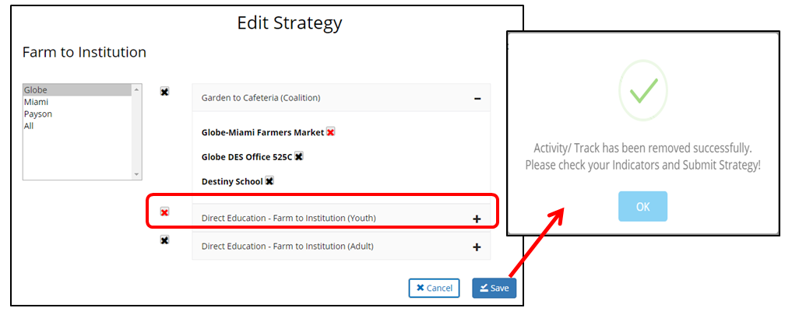
Community Level

Slide 6
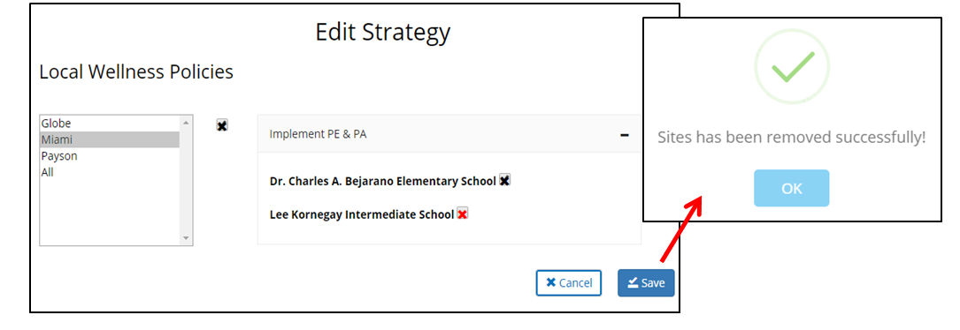
Site Level

Slide 7
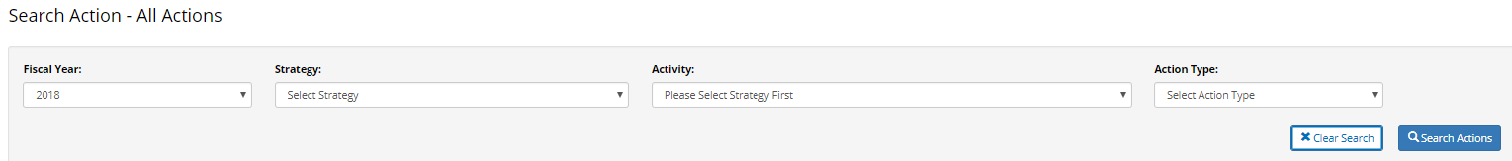
Enhancements-Action Search
You will now have search filters for:
  Fiscal Year, auto populates to 2018
  Strategy
  Activity
  Action Type
  **Please note that the “Search Action” button will need to be pressed before the search action bar is displayed. **
Notes:
Please note that the “Search Action” button will need to be pressed before the search action bar is displayed.
** FY 2018 is automatically populated, and filter search fields are not mandatory.** Having the completed FY field will yield results.

Slide 8
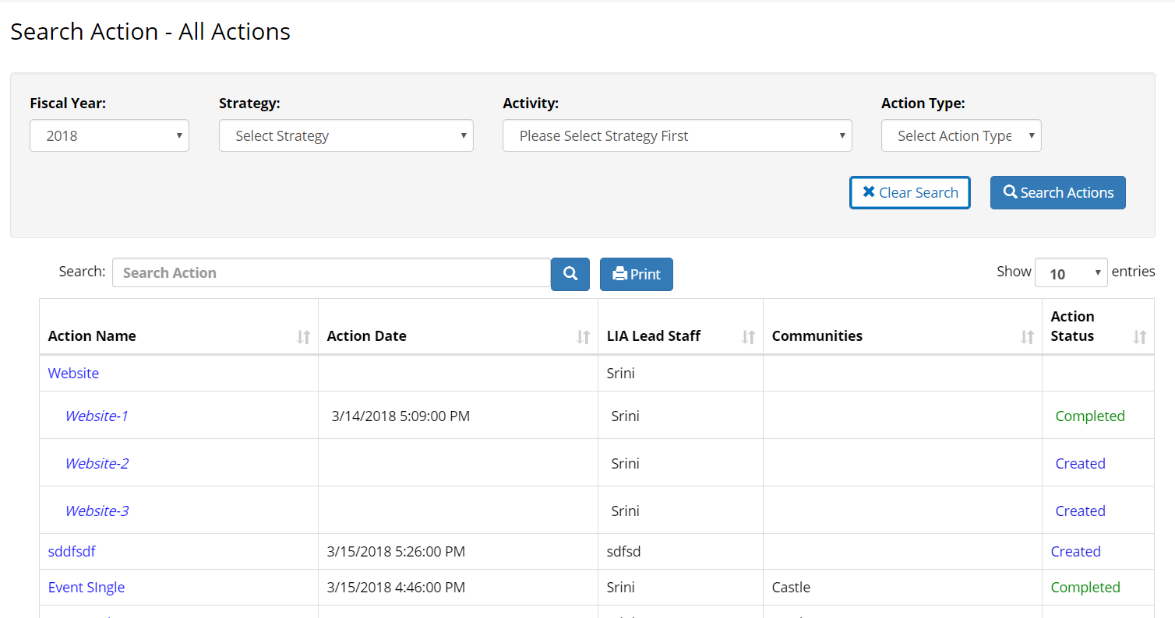
New Action Search Page

Slide 9
Search functionality will remain the same
Still allow you to type into the search bar and search for keywords that are showing in the table:
  Action Name
  Action Date
  LIA Lead Staff
  Communities
  Action Status
Notes:
Please note there are still some issues with the sorting, this is due to there being both Main Actions and Sub-Actions, currently the system will group sub-actions first then all main actions.

Slide 10
DE & Supplemental Actions
We have received questions about logging DE with supplemental actions
  Key guidance:
  If supplemental activities are completed within the Modification Guidelines then they should be included as a sub-action with the DE Action.
    Example: food demos completed with a DE lesson.
    SEEDS now has a checkbox where you are able to indicate when a food demo was done within your DE lesson

Slide 11
New Functionalities
Create Action/Partnership
Implementation Stage

Slide 12
Create Partnership
In this feature you will be working to document those partnerships you have created and grown within your communities.
This will function similarly to the other Create Action functions in SEEDS.
You will be able to add to your “Partnership” actions throughout the fiscal year.

Slide 13
When to Create Partnership
Working relationship with an outside organization and assistance was either: provided, received, or both during the Federal Fiscal Year.
Per the USDA, partnerships do not included entities that receive direct SNAP-Ed funding, but instead include other sites and organizations that support or are involved with SNAP-Ed work.

Slide 14
When to Create Partnership/Example
While every site has a partnership, not every partnership has a site.
  When Booktown Library allows us to hold classes at their location, they are providing space for SNAP-Ed to operate (perhaps among other things).
Other partnerships may not have direct delivery sites.
  For example, you may be partnering with the Arizona Department of Agriculture to host local Food Summits.

Slide 15
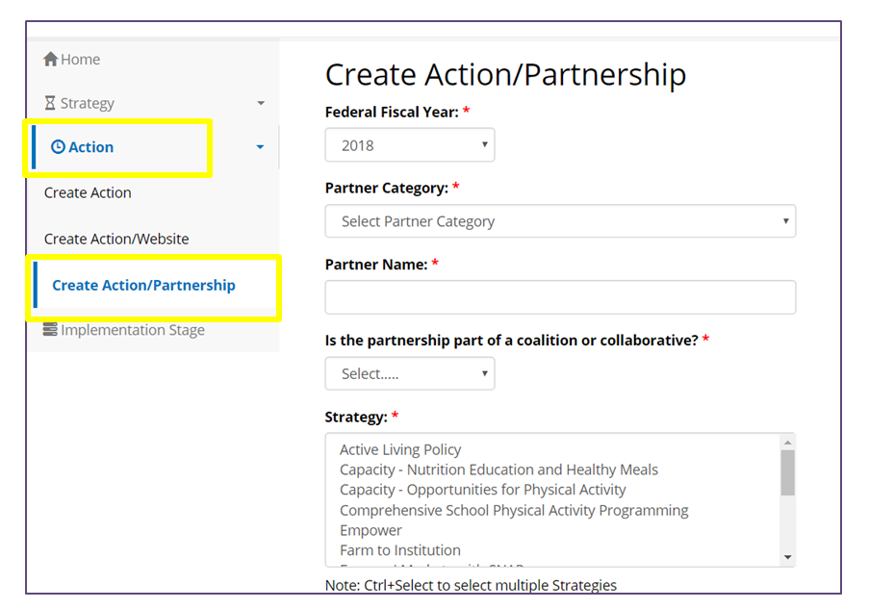
Create Action/Partnership
Notes:
You will access the Create Action/Partnership via the left side Navigation bar under Action, by clicking on it, then all of the Create Action buttons will display

Slide 16
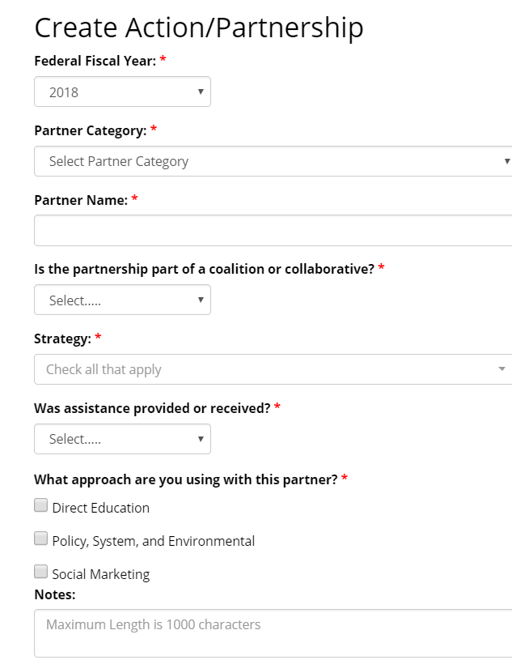
Fields for Create Action/ Partnership
Notes:
All drop down lists/Options are those provided by USDA.

Slide 17
Partner Category Options
Select only one:
Dropdown options include:
Agricultural organizations
Chefs/culinary institutes
City and regional planning groups
Early care and education facilities
Faith-based groups
Food banks/food pantries
Food stores
Foundations/philanthropy organizations/nonprofits
Government program/agency
Hospitals/healthcare organizations
Human services organizations
Indian Tribal organizations
Labor/workforce development groups
Media/advertising groups
Parks and recreation centers
Public health organizations
Restaurants
Schools (K-12)
Schools (colleges/universities)
Transportation groups
Worksites
Other (please specify):
Notes field will be enabled if other is selected, Free text.

Slide 18
Is the partnership part of a coalition or collaborative?
Here you will indicate if this partnership is limited to your agency and the partnering agency OR if it is a partnership through a larger collaborative effort such as a coalition.
Options include: Yes/No

Slide 19
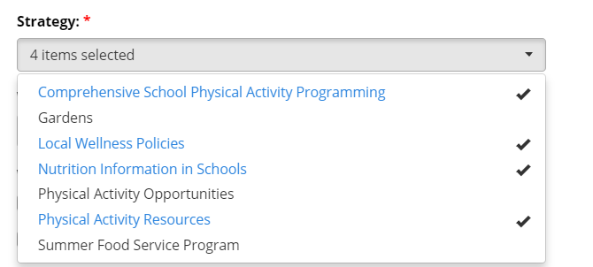
Strategy Multi-Select

Slide 20
Was assistance provided or received?
Select only one.
Options Include:
  Assistance Provided
  Received
  Both
  ***Your selection will enable the boxes to enter further information.***

Slide 21
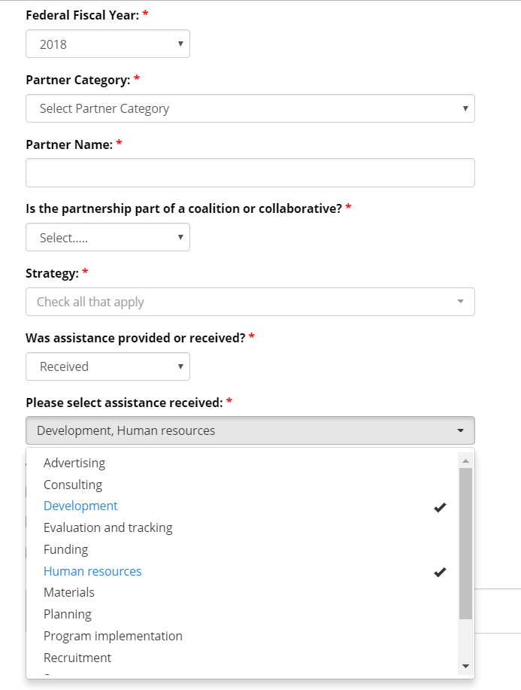
Enabled Assistance Recieved/Provided
Notes:
Similarly to the scrolling Checkboxes for Strategy. Assistance Received and Provided will also have the same function.

Slide 22
Dropdowns for Assistance
Select all that apply:
Advertising
Consulting
Development
Evaluation and tracking
Funding
Human resources
Program implementation
Materials
Planning
Recruitment
Space
Technical services
Other (please specify):
  Notes field will be enabled if other is selected, Free text.

Slide 23
What approach are you using with this partner?
Please check all that apply.:
  Options include:
    Direct Education
    Policy, System, and Environmental
    Social Marketing

Slide 24
Save Partnership
For Partnerships, we will only have “Active” and “Canceled” status.
Once a partnership is “Active” with all the required fields, nothing else is needed, unless you would like to add to the partnership within the same FFY.
Notes:
LA admins ONLY can cancel partnerships.

Slide 25
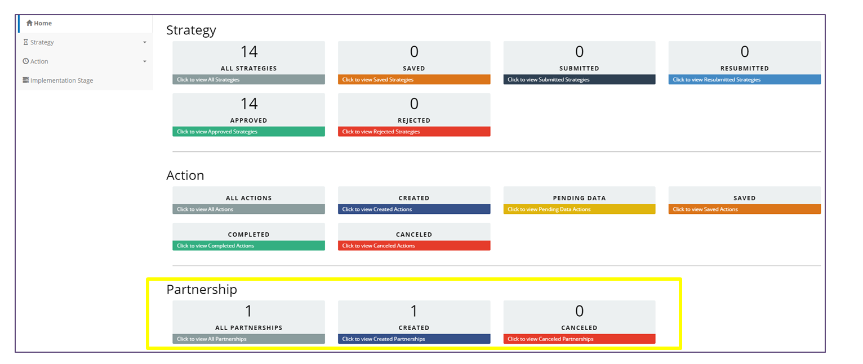
Adding to an Existing Partnership
Notes:
If you would like to view and/or add information to a partnership that is already active for the current fiscal year, you can go to the Home/Dashboard page and find the partnership boxes at the bottom. They will be organized by status similarly to Strategy and Action boxes. For Partnerships, we will only have “Active” and “Canceled” status. Once a partnership is “Active” with all the required fields, nothing else is needed, unless you would like to add to the partnership within the same FFY.

Slide 26
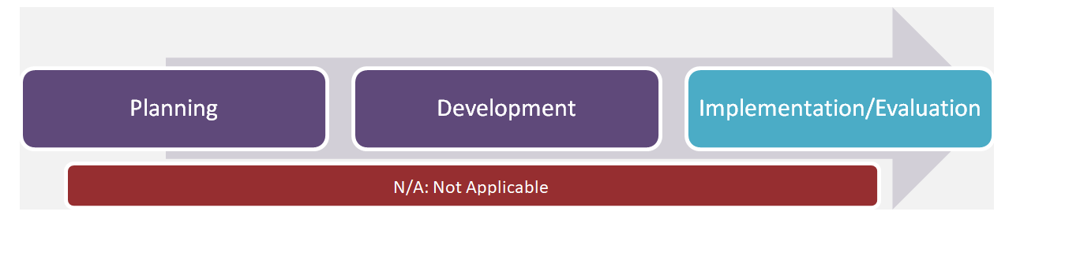
Implementation Stage
Is an indication of the “stage” of an activity by site.
Options include:

Slide 27
Implementation Stage
Completed biannually to coincide with the Semi-Annual Report Narrative (SARN) due dates.
Will be shown/available for the remainder of FFY18.
  FFY19 will only be available in the system during the reporting time frame.
Initially you will indicate the stage, but for the Year End SARN, updates will only be required if there was a change to your Implementation Stage.

Slide 28
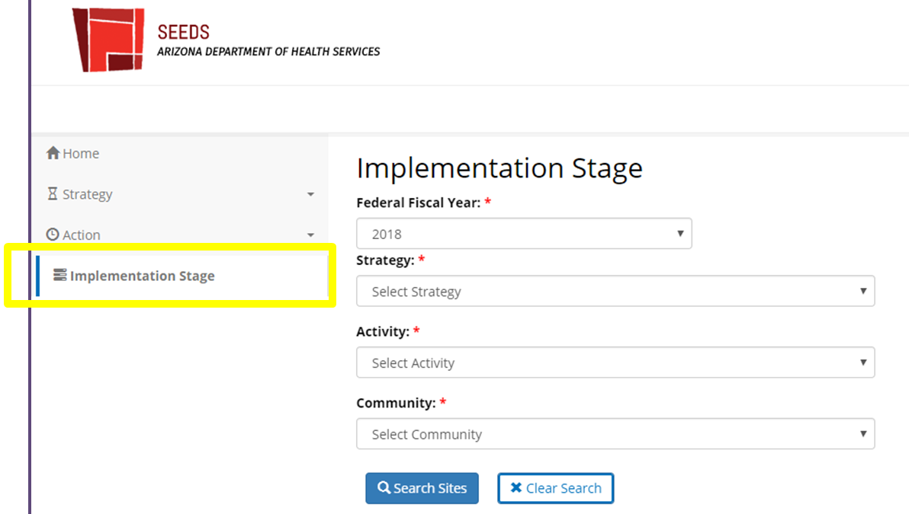
Implementation Stage

Slide 29
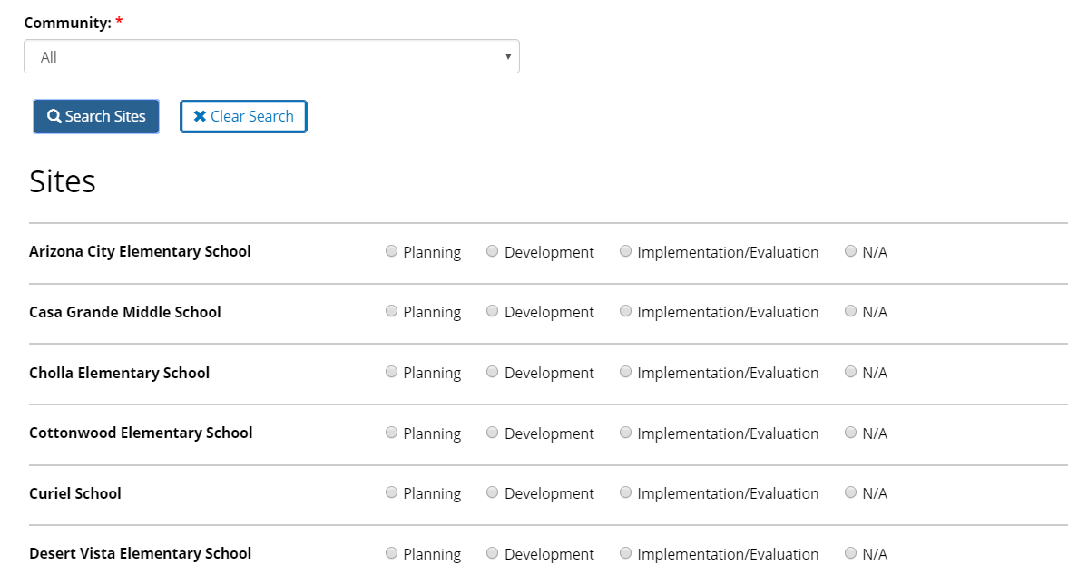
Search Using Dropdowns
Only approved Strategies, Activities, Communities will display
Community has an “ALL” option
Notes:
Please note, give the system a minute to pull the dropdowns based on your previous selection.

Slide 30
Select and Save Stage
You do not have to select a stage for each site
  BUT…Once a stage has been selected, you cannot leave blank
You can only update one site
You can change the stage to move forward or backward
N/A should be selected when work has been stopped or the wrong selection was made in error
After you indicate a stage other than N/A the site cannot be removed from Strategy/Activity combo

Slide 31
Guidance of Implementation Stage by Activity
Focus Area Specialists have created a document that describes the “Implementation” for each activity.
It can be found in the User Guide for Phase 3.

Slide 32
Returning to Implementation Stage
If you would like to access implementation stage after your initial selection, you will do it in the same manner, via navigation bar.

Slide 33
Next Steps
Phase 4 of SEEDS is expected to be released later this spring. It will include enhancements to the SIT administrative screens and build out the remaining assessments planned for FFY2019-FFY2020.
Because Phase 4 does not include changes to the LIA interface, there will not be any additional training for LIAs during this phase.

Slide 34
Questions
Please feel free to reach out to the State Implementation Team with any questions, email us at AzHealthZone@azdhs.gov

